Slide 1

Double Trouble: A Tale of TB in Two Cities
Amina Ahmed, MD
October 6, 2021

Slide 2
Patient 1 (Charlotte)
15 year-old with sickle cell disease (SS)- severe phenotype
Lives in Mecklenburg County
April 2012- acute chest requiring intubation and ventilation
August 2012- stroke with infarcts
June 2021- admitted for bone marrow transplantation
May 2021- CXR and CT read as abnormal
June 2, 2021- bronchoscopy
July 14, 2021- notified of positive AFB

Slide 3
Patient 2 (Greensboro)
2 year old evaluated for upper airway pathology
From Guilford County
Born at FT gestation; moved to Utah at 4 weeks of age
Frenulectomy at 9 weeks for difficulty breastfeeding
Continued problems with suck/swallow/gagging
Gastrostomy tube at 17 months of age; moved to NC
June 2, 2021- triple scope Laryngeal cleft lasered; GI scope with no findings; bronchoscopy showed edema and secretions
July 14, 2021- called re AFB from bronchoscopy

Slide 4
Patient 1: Further History and Physical Exam
History
No cough, fevers, adenopathy, weight loss
Lives with mother and sister
Lived in Florida, Michigan, Mississippi, North Carolina
Homeless shelter for 4 months in 2016
Mother’s ex-BF “had TB” but family not tested
Evaluation
No TST or QFT done prior to transplant
TST nonreactive, QFT indeterminate (on immunosuppressives)
Sputum collected- GeneXpert negative

Slide 5
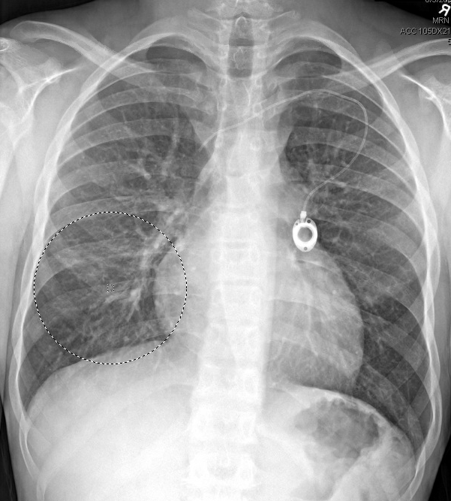
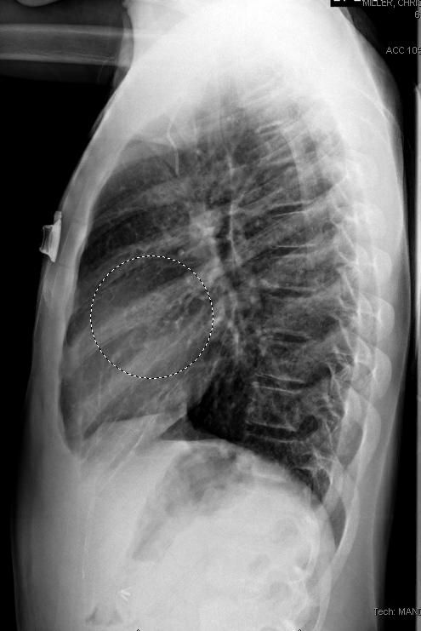
Patient 1: CXR

Slide 6
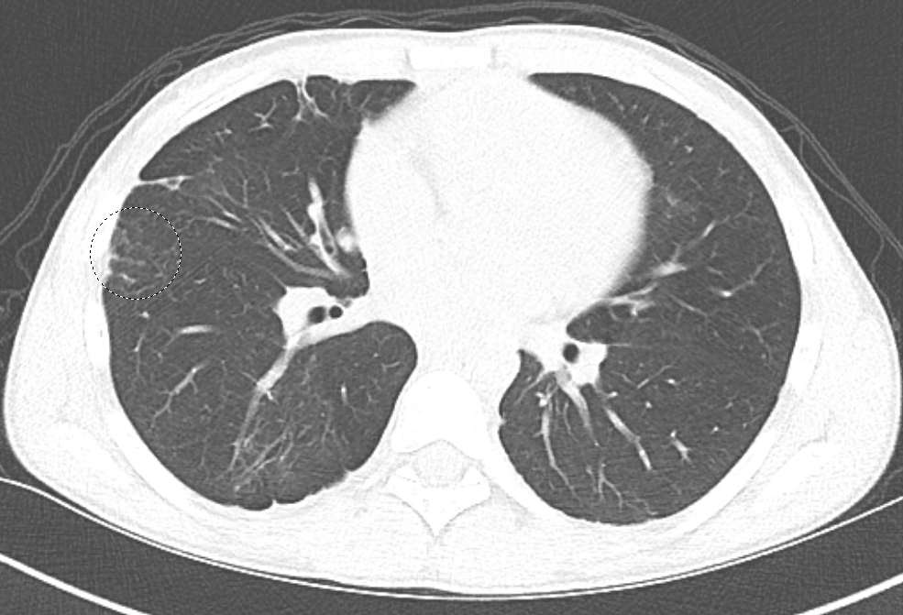
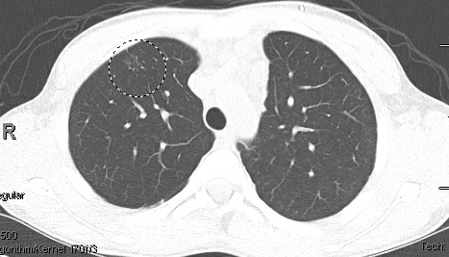
Patient 1: Chest CT
Pleuroparenchymal scarring with air trapping and tree-in-bud mucoid impaction.
Multi compartmental indeterminate prominent lymph nodes- difficult to assess given lack of contrast.

Slide 7
Patient 2: Further History and Physical Exam
History
No history of fevers, cough, weight loss, adenopathy
No travel except Utah
No ingestion of unpasteurized products
Evaluation
QFT negative, TST nonreactive
Parents with negative TSTs; sibling not tested
CXR normal (done after diagnosis)

Slide 8
Tale of Two Specimens
6.2.21
Endoscopy
Patient 1
8:03 am
Bronchoscopy completed
Dr. C
Patient 2
8.09 am
Bronchoscopy completed
Dr. D
6.2.21
Laboratory
Patient 1
Specimen received; set up 6.3.21
Patient 2
Specimen received; set up 6.3.21
6.22.21
MGIT Alert
Patient 1
MGIT tube alerted as positive- smear negative for AFB
6.25.21
MGIT Alert
Patient 2
MGIT alerted positive- smear negative for AFB
7.15.21
MGIT Terminal Smear
AFB Detected; probe positive for MTB 7.15.21
AFB Detected; probe positive for MTB 7.15.21

Slide 9
False Positive M. tuberculosis Culture?
Approximately 1-3% of all MTB cultures are false positive results
Mechanisms
Contamination of clinical equipment (e.g. bronchoscope)
Cross-contamination of specimens in laboratory
Batch processing, contamination of reagent
Pipette contamination
Clerical errors (e.g. mislabeling)
Reporting errors

Slide 10
Review of False-Positive Cultures for M. tuberculosis
Review of 14 studies evaluating > 100 patients
False-positive cultures were identified in 13 (93%)
Median false-positive rate was 3.1 %
Of 236 patients with false-positive cultures reported in detail, 158 (67%) were treated
Toxicity, unnecessary hospitalization/testing/contact investigation
Having a single positive culture was a sensitive but nonspecific criterion for detecting false-positive cultures.
TB control programs should develop procedures to identify patients with only 1 positive culture.
Clin Infect Dis 2000; 31: 1390

Slide 11
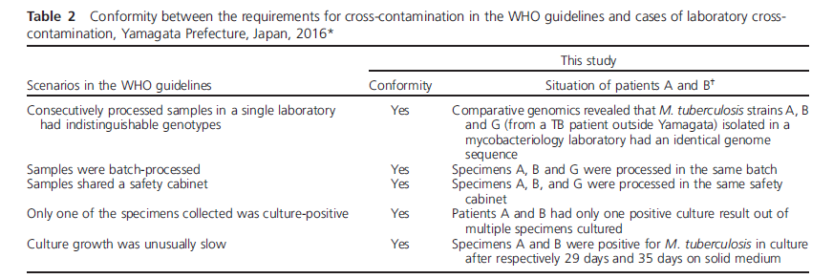
IJTLD 2018: 22: 1239

Slide 12
Who Dunnit?
Endoscopy suite
Two separate rooms, two separate surgeons, two separate scopes
Did specimens get mixed up?
Laboratory
Contamination in processing?
Contamination when alerted? Pipette?
Resampled MGITs- both positive again
Next steps
Genotyping

Slide 13
Molecular Tests for the Diagnosis and Management of Tuberculosis
Diagnosis
Polymerase chain reaction (PCR)
GeneXpert
Drug susceptibility
Molecular Detection of Drug Resistance (MDDR) Service
Genotyping

Slide 14
Genotyping
Laboratory-based approach that analyzes genetic material (DNA) of M. tuberculosis (MTB)
Total genetic content is referred to as the genome
Specific sections of the MTB genome form distinct genetic patterns that help distinguish different strains of MTB
TB genotyping methods have changed with advances in technology.
Conventional TB genotyping
Whole-genome sequencing (WGS)

Slide 15
Conventional TB Genotyping
Spoligotyping
Spacer oligonucleotide typing
Presence/absence of spacer sequences found in a direct-repeat region of genome
MIRU-VNTR
Mycobacterial interspersed repetitive unit-variable number tandem repeats
Distinguishes strains by the difference in the number of copies of tandem repeats at specific regions, or loci, of the genome

Slide 16
Genotyping Results and Reporting
Results of conventional genotyping reported as codes
Spoligotyping- 15 digit code
MIRU- 12 or 24 digit code
TB genotypes defined as a unique combination of spoligotype and MIRU-VNTR results.
PCRType (e.g. PCR00002)
In 2009, MIRU-VNTR analysis was expanded from 12 loci to 24 loci
New national naming system called GENType

Slide 17
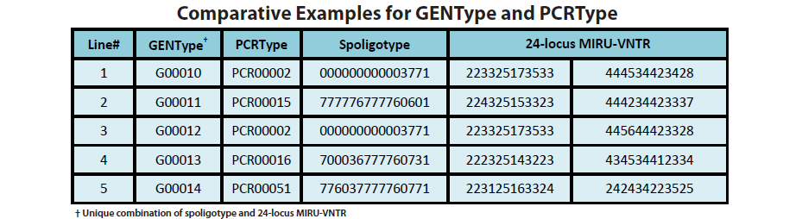

Slide 18
Whole Genome Sequencing
Generates DNA sequence data for entire (almost entire) MTB genome
Whole-genome single nucleotide polymorphism (wgSNP)
SNPs result from mutations at a single position (A, T, C or G) in the DNA sequence; these accumulate over time and comparing across isolates can provide information about cases resulting from recent transmission
SNPs mapped to phylogentic tree to diagram relationship among isolates
Whole-genome multilocus sequence typing (wgMLST or wgMLSType)
2,690 different genetic loci analyzed
Isolates matching at ≥99.7% of the loci form genotype cluster, called wgMLSType
Will replace GENType and PCRType for alerting TB clusters.

Slide 19
Genotyping: Timeline
2004
Spoligotyping and MIRU
Reported out as PCRType (12 loci)
2009
MIRU added another 12 loci (24 loci)
Reported out as GenType
2018
National TB Molecular Surveillance Center established
2021
WGS reported out as wgMLSType
Whole genome sequencing (WGS) routinely done on all isolates
Whole-genome single nucleotide polymorphisms (wgSNP)

Slide 20
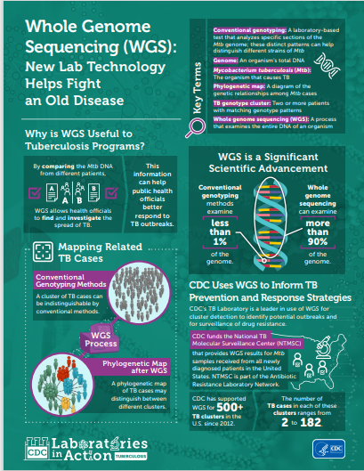
Who You Gonna Call?
National TB Genotyping Service (NTGS)
Provides conventional genotyping (2004)
TB Genotyping Information Management System (TB GIMS)
Secure web-based system for access to and dissemination of genotyping information nationwide
TB Genotyping | TB | CDC

Slide 21
Why use genotyping?
Contact investigation
Confirm or refute patient connections; find previously unidentified contacts
Determine completeness of contact investigations
Transmission
Identify unsuspected transmission or unknown transmission settings, such as bars or clubs
Measure extent of transmission
Uncover inter-jurisdictional transmission
Differentiate reactivation from recently acquired infection
Important for allocation of resources and elimination efforts
Detect laboratory cross-contamination event

Slide 22
Back to Our Patients…
8.5.2021
MIRU/MIRU2 genotypes match for the 2 patients
Match with Mecklenburg County 85 year old diagnosed earlier 2021
8.6.21
wgMLSType, GenType and PCRType match each other and the 85 year old case
wgSNP requested
8.26.21
Phylogenetic tree does not rule out contamination but also does not rule out recent transmission.
Only other recent case with the genotype is 2020 TN case, 10 SNPs away
CDC molecular epidemiology team:
Rely on information in the local lab, and the treating physician’s judgement when making a decision about contamination

Slide 23
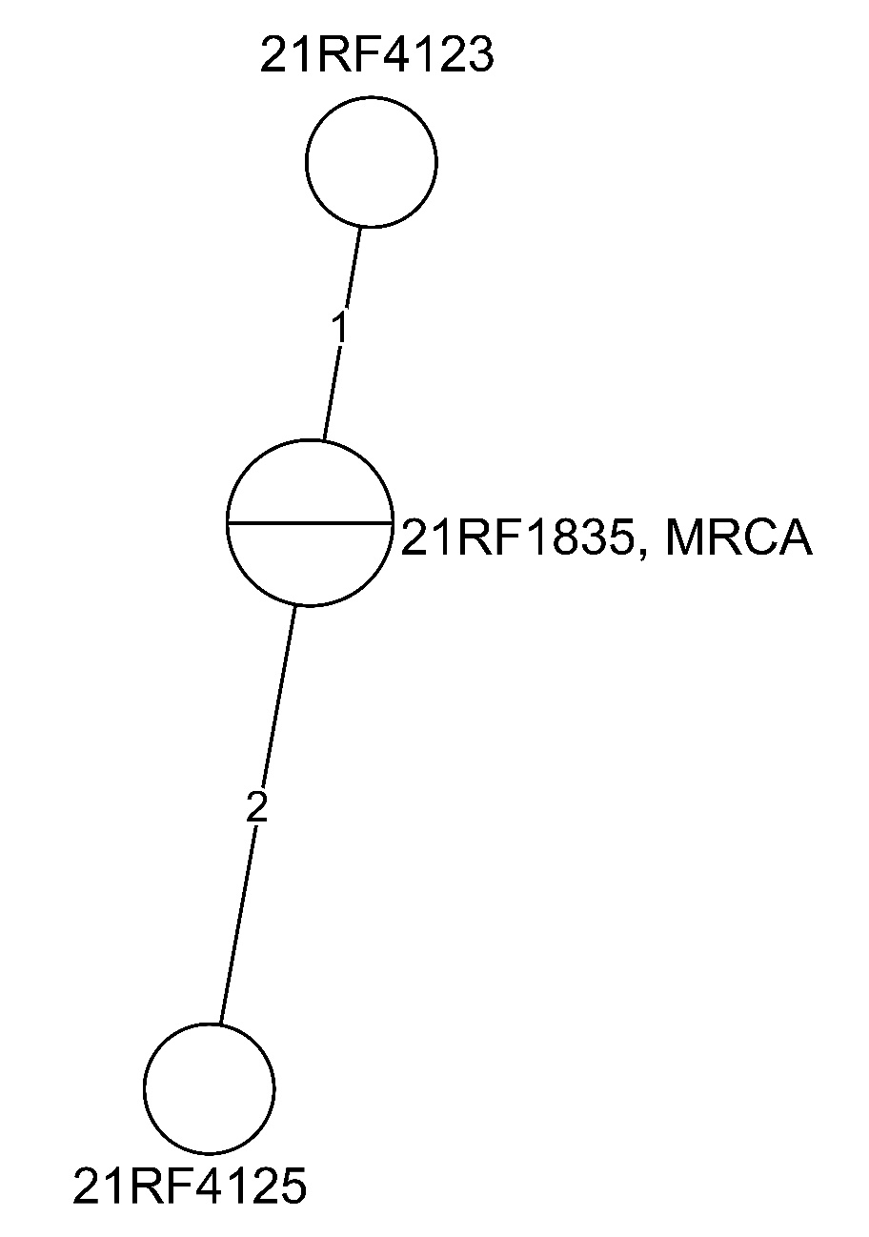
MTBC012305/G10365 in North Carolina
Results received 08/09/2021
Interpretation:
Isolates are shown as circles (called nodes) and are labeled with the isolate accession number
Isolates with the same genome type (i.e., same sequence) are displayed together in one node
Nodes are connected by lines proportional in length to the number of SNPs that differ between the isolates
The lines are labeled with the number of SNPs
MRCA = Most Recent Common Ancestor
Hypothetical genome type (not an actual isolate) from which all isolates on the tree are descended
Serves as a reference point for examining the direction of genetic change ( )

Slide 24
Genotype Cluster
Two or more MTB isolates that match by genotyping methods (i.e., same spoligotype and MIRU patterns)
Patients who are members of the same genotype cluster are assumed to have the same strain
Implies recent transmission, but only one piece of the puzzle
Need epidemiological linkages including spatial (geography) and temporal (time) associations, and drug susceptibility results (phenotype)

Slide 25

Guide for interpreting the phylogenetic tree
=
genetically distant, and unlikely to be involved in recent transmission
24
9
MRCA
6
10
1
1
6
Closely related isolates, which may be involved in recent transmission
1
18
1
2

Slide 26
Now What??
Patient 1
Additional specimens obtained
Due to underlying diagnoses and immunosuppression as well as epidemiologic history, started on anti-tuberculosis treatment
Remains clinically stable
Patient 2
Due to no epidemiologic history to support diagnosis, not treated
Further investigation- requested CXRs on parents and sibling
Remains clinically stable

Slide 27
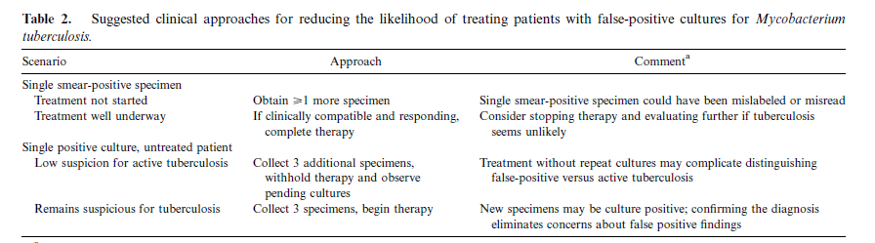
Approach to Suspected False-Positive MTB Culture Results
Clin Infect Dis 2000; 31: 1390

Slide 28
Role of Genotyping for Pediatric TB
Source-case investigations
Differentiate reactivation from recent infection
Define patterns of transmission
False-positive laboratory diagnoses

Slide 29
Contact versus Source Investigation
Contact investigation
Process to identify persons (contacts) who were exposed to someone with infectious TB disease; assess contacts for infection/TB
Source case investigation
Process to identify a source for infection
Usually done when a young child is found to have TB disease
If source has an isolate, can be used for treatment of child
To prevent further transmission from an infectious person

Slide 30
Diagnosis of Pediatric TB
Diagnosis of childhood TB is difficult
Symptoms and radiographic findings are nonspecific
Specimens difficult to obtain
Microbiology limited by paucibacillary disease
Most childhood TB is not culture-confirmed
Diagnosis relies on:
Epidemiologic factors
Immunologic findings
Clinical presentation
Radiographic findings

Slide 31
Diagnostic Tools for Pediatric TB
Latent tuberculosis
TST, IGRAs
TB Disease
TST, IGRAs
Radiological
CXR
US, CT, MRI
Microbiological / molecular
Microscopy, culture
NAAT, Xpert MTB/RIF
Source investigation

Slide 32
Microbiological Diagnosis of Pediatric Tuberculosis
Bacteriologic confirmation difficult in children
Sputum difficult to obtain in children < 12 y
Gastric aspirate collection requires hospitalization
Tubercle bacilli sparse
Lack of a practical gold standard in children with TB
MTB isolated in < 30-60% of children
Negative culture does not exclude TB
AFB smear positive in <10-15% of children
Negative AFB smear does not exclude TB

Slide 33
Management of Suspected TB
Child identified through contact investigation (source case known)
Use source case’s isolate to guide treatment of child
If drug resistance suspected, attempt bacteriologic confirmation
Symptomatic child (source case unknown)
Bacteriologic confirmation should be attempted
Source case investigation
Likelihood of identifying source case (and isolating MTB) is higher than isolating MTB from patient

Slide 34
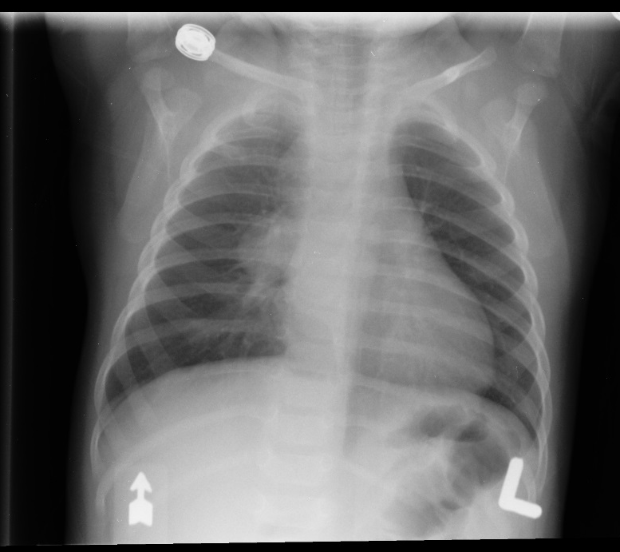
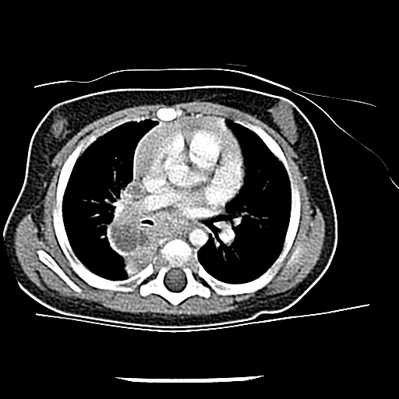
It’s a Family Affair
5 month old Hispanic female evaluated in ED with a cough
CXR - hilar adenopathy
Admitted for evaluation

Slide 35
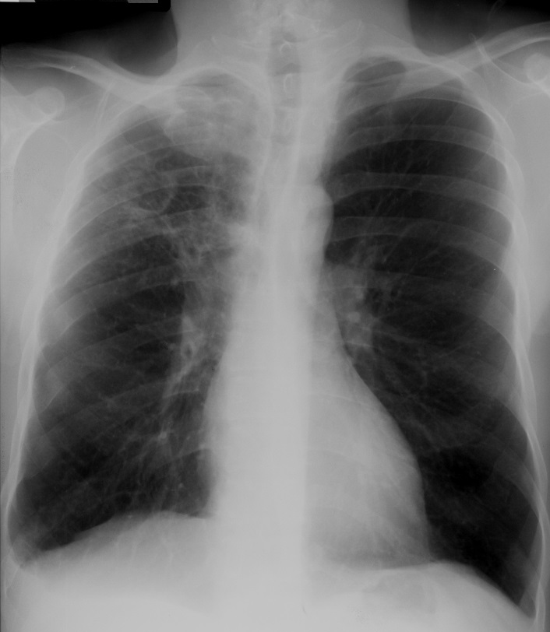
It’s a Family Affair
Gastric aspirate X 3
Induced sputum X 1
CSF: 0 WBC, O RBC, protein 30, glucose 55
4 drug regimen initiated
Source case hunt
4 siblings with LTBI
Parents with LTBI
Isolation of MTB from GA specimen- matched source’s

Slide 36
Genotyping for Source Investigation for Pediatric Patients
Pediatric TB cases are sentinel events for recent TB transmission.
Source-case investigations potentially identify additional TB cases, confirm suspected transmission links between source case and child, or identify
previously unsuspected, venues of transmission
Genotyping supports evidence of the transmission if the isolates match
If no suspected source case, genotyping results from patients living in the same area may identify a match and potential source

Slide 37
Role of Genotyping in Determining Source Case
Population-based study conducted in seven U.S. sites, 1996 to 2000
Culture attempted in 270 (52%) of 518 patients < 5 years of age with TB
122 (45%) culture confirmed; 114 genotyped
Suspected source case identified for 57 cases; 52 pairs had genotype results
44 (85%) were concordant
8 (15%) suggested infection with different TB strains
Discordant genotypes found in same household
Pairs with discordant drug susceptibility had same genotypes
Only 93% concordance for drug susceptibility results between child and source
Emerg Infect Dis 2002: 8: 1216

Slide 38
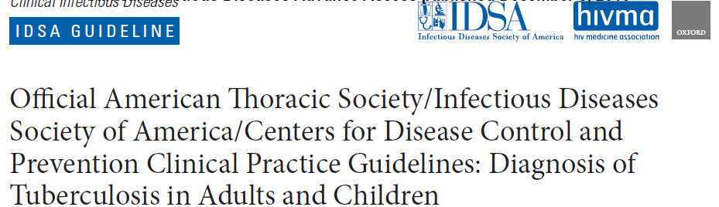
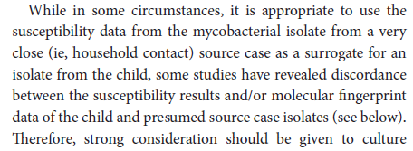
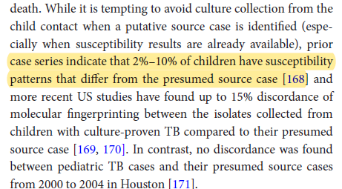
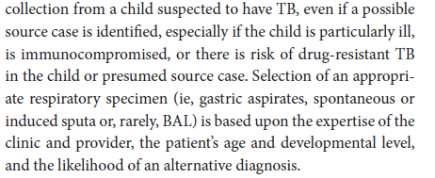
Clin Infect Dis 2016

Slide 39
Genotyping for Evaluation of Reinfection
Recurrence of TB in healthy children is rare
2 month old diagnosed with military TB/CNS TB
Gastric aspirate positive for MTB by culture; BAL positive by MTB PCR
Parents diagnosed with LTBI; could not prove congenital infection
Mother’s gynecologic exam and clinical exam was normal
Treated for 11 months
6 months after completion, both parents admitted for TB
Infant asymptomatic but abnormal CXR noted- BAL culture positive for MTB
Ped Infect Dis J 2020; 39: e207

Slide 40
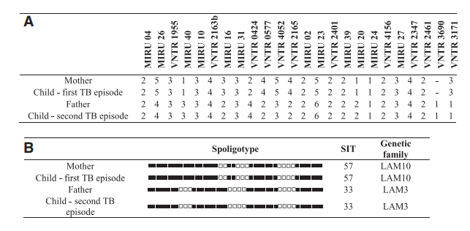
Samples from both infant episodes and parents’ specimens submitted for genotyping
Matching genotypes between mother’s strain and infant’s first strain
Matching genotype between father’s strain and infant’s second strain

Slide 41
Genotyping to Understand Transmission
49 culture-confirmed cases of pediatric TB in British Columbia (BC)
23 children Canadian born (7 to Canadian born parents, 16 to foreign-born parents)
26 foreign-born children
Using genotyping and epidemiologic history, found that 15 children acquired infection in BC
Significantly higher than predicted by genomic studies in adults in the province, the majority of whom have reactivation type disease
J Infect Dis 2018: 218: 115

Slide 42
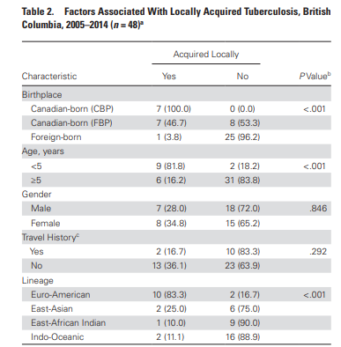
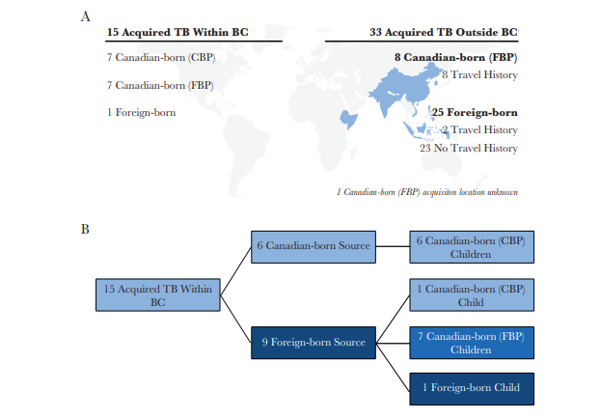
J Infect Dis 2018: 218: 115

Slide 43
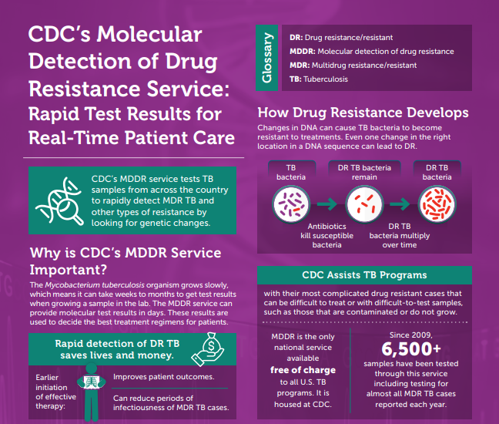
Genotyping for Resistance Testing
CDC evaluates WGS data to detect mutations associated with drug resistance for surveillance purposes.
MDDR Service provides rapid testing for resistance to aid clinical management.

Slide 44
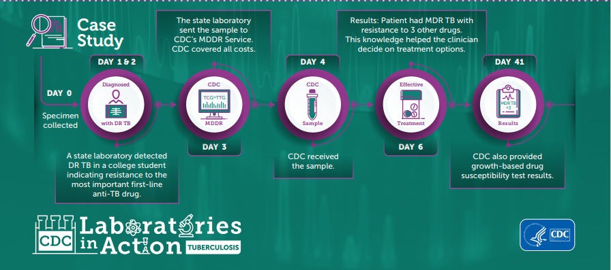

Slide 45
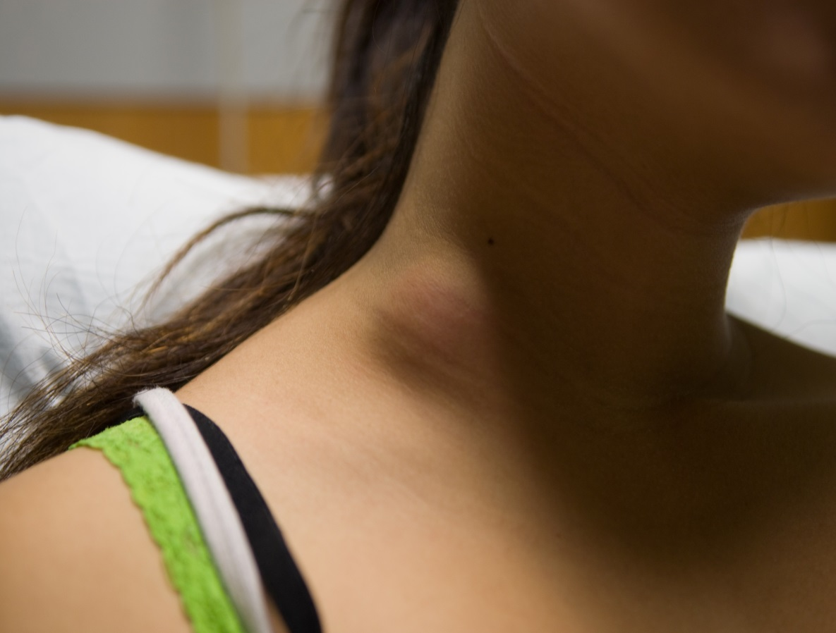
Like mother, like daughter
16 year old Vietnamese girl with cervical adenitis
Referred to pulmonologist →TST placed → referred to surgeon
TST 21 mm
CXR normal

Slide 46
Summary
Genotyping plays important roles in diagnosis and treatment of pediatric tuberculosis
Source investigation
Dynamics of transmission
False-positive culture results
Ultimately, genotyping is a tool that will aid in the elimination of tuberculosis

